Slide 1
RDBMS IA-1
Shubham Prabhu
A3-1911040

Slide 2
A Fighting Game AI Using Highlight Cues for Generation of Entertaining Gameplay
Ryota Ishii, Suguru Ito,
Ruck Thawonmas, Tomohiro Harada

Slide 3
Introduction
The need for this paper:
  In recent years, live streaming platforms such as Twitch and YouTube have become popular. A large group of spectators watch gameplay videos called “Lets Plays” to entertain themselves.
  As a result, these type of spectators have gained a lot of interest by researchers in various areas.
  Thus it is important to understand how the most efficient and entertaining gameplay can be obtained.

Slide 4
Generating gameplay
In this paper, the Monte Carlo Tree Search is used for gameplay generation.
However, the evaluation function for the MCTS(Monte Carlo Tree Search) has been changed.
A combination of highlight indicators or cues is used in the evaluation function of MCTS.

Slide 5
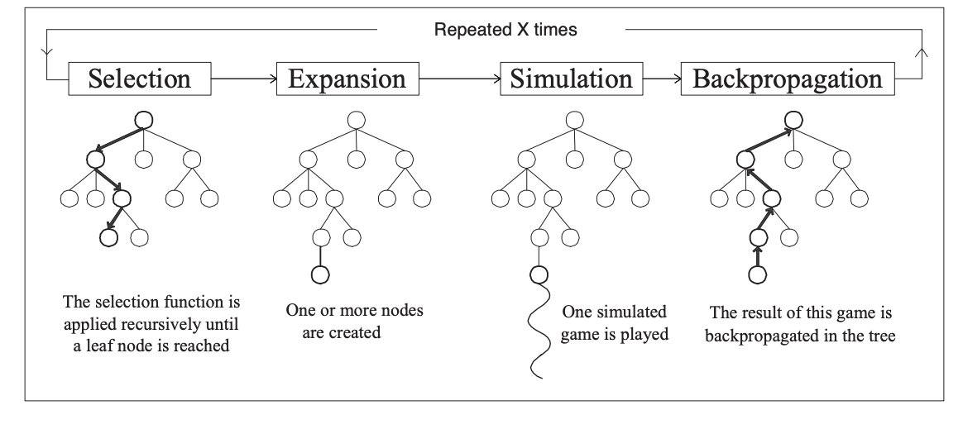
Monte Carlo Tree Search
MCTS

Slide 6
Monte Carlo Tree Search (MCTS) is a search technique in the field of Artificial Intelligence (AI).
It is a probabilistic and heuristic driven search algorithm that combines the classic tree search implementations alongside machine learning principles of reinforcement learning.
In tree search, there’s always the possibility that the current best action is actually not the most optimal action. In such cases, MCTS algorithm becomes useful as it continues to evaluate other alternatives periodically during the learning phase by executing them, instead of the current perceived optimal strategy. This is known as the ” exploration-exploitation trade-off “.
It exploits the actions and strategies that is found to be the best till now but also must continue to explore the local space of alternative decisions and find out if they could replace the current best.
The MCTS algorithm takes place in four steps:
  Selection
  Expansion
  Simulation
  Backpropagation

Slide 7


Selection:
  This is the most important step for our paper as this is where we will be making our proposed changes
  Nodes are selected from the root node until a leaf node is reached according to a selection criterion in use.
  The selection criterion used here is called Upper Confidence Bounds (UCB1) and is shown as
  Here Nii is the number of times node (action) i has been visited, N is the number of visits to its parent node, and C is a constant.
  Xi is the average evaluation function and is given by
  The Evalj is the evaluation function that we will be finding out by our proposed method

Slide 8
Expansion:
  In this process, a new child node is added to the tree to that node which was optimally reached during the selection process.
Simulation:
  In this process, a simulation is performed by choosing moves or strategies until a result or predefined state is achieved.
Backpropagation:
  After determining the value of the newly added node, the remaining tree must be updated. So, the backpropagation process is performed, where it back propagates from the new node to the root node. During the process, the number of simulation stored in each node is incremented. Also, if the new node’s simulation results in a win, then the number of wins is also incremented.

Slide 9
Proposed Method
The evaluation function for the MCTS has been changed in the Proposed method.
Three highlight cues are introduced to form the evaluation function of MCTS: “Score Transition,” “Action,” and “Distance ”.
All of them are expected to increase aggression in gameplay, which is what spectators demand in both traditional sports and esports.

Slide 10


Score Transition:
  Score Transition is a term that combines the elapsed time of the current round and the predicted damage value that the AI player gives to its opponent. This term, Score, is defined as follows:
  where RoundTime and Damage represent the elapsed fight time and the damage value at the end of the current simulation, respectively. According to this term, the AI player prioritizes actions with high damage values, and this kind of an earnest fight is more prominent as the time is closer to the end of theround.
Action:
  Action prioritizes certain actions by the AI player and is defined as follows:
  where RankAct is a list of actions, and Rank is the value associated to each action in the list.

Slide 11


Action:
  The list of actions is shown as follows
Distance:
  Distance prioritizes a close-distance fight near the center of the screen and is defined as follows:
  where center is the x coordinate at the center of the screen, and X pos is the AI player’s x coordinate. Distance will have a higher value when the AI player is positioned closer to the centre of the screen.

Slide 12

Evaluation Function
Finally the evaluation function is given by:
where the values of Score, Action and Distance are normalized in a range of 0 to 1.
The values of their weights ωs, ωa, ωd are changed according to the experiments

Slide 13
Experiments
The Experiments were carried out in an environment called as FightingICE. FightingICE is a real-time 2D fighting game platform used in a game AI competition and for research.
Rules:
  Every round lasts for 60 seconds and the games is rendered at 60 fps(frames per second).
  At the start of a round the max HP of both AI players is set to 400.
  Round ends when the timer runs out of 60 secs or the HP of either player reaches 0.

Slide 14
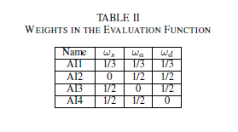
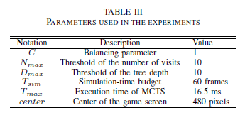
The test were taken considering 5 AI players with a typical MCTS AI player(mAI) and four other AI players with the following changes in their weights for the evaluation function:
Apart from this the following parameters were set for the user study:

Slide 15
User Study
The user study was taken by 66 participants, 57 males and 9 females with an average age of 24.1± 2.5
They were asked to watch two gameplay video clips: a gameplay video clip where both AI players are of the mAI type and the other gameplay video clip where both AI players are of the same type selected from one of the other four AI players.
Then, given no information on how each gameplay was generated, they were asked to answer which gameplay was more fun and to comment their reasons for selection.
Three rounds were generated by two AI players of the same type, and the content in the last 30 seconds of a round was recorded. The user study was conducted on an online survey site which displayed a pair of gameplay video clips of the same but randomly selected round number.
To test statistical differences between any two methods, the exact binomial test was used on amalgamated results from all three rounds.

Slide 16
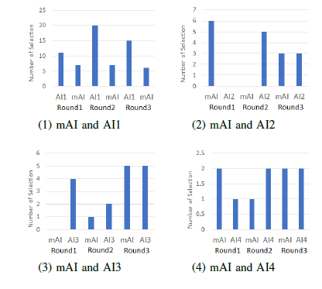
Results

Slide 17
In general, the majority of users preferred the gameplay of AI1 over the others for all rounds, indicating the positive effect of using all of Score Transition, Action, and Distance.
On comparison of mAI with AI2, it can be observed that for Round 2, due to the absence of Score Transition in AI2, a close-range fight using the actions in the RankAct list was continuously performed in the center of the screen throughout the fight. Therefore, the fight was sometimes repetitive causing the participants to not enjoy the gameplay.
On comparison of mAI witj AI3,it can be observed that in the gameplay by both AI3 players, a fight occurred near the center of the screen and became more tensed as the fight time increased, but the frequency of using actions, with high visual effects, in RankAct decreased.
On comparison of mAI with AI4,it can be observed that because there was no Distance in AI4, each of the AI4 players used actions in RankAct throughout the round, causing a lot of damage to the opponent especially in the second half of the round, but they could not reduce the distance to the opponent. As a result, long-distance attacks were repeated, so there were not many changes in the fight causing the participants to find it not so fun.

Slide 18
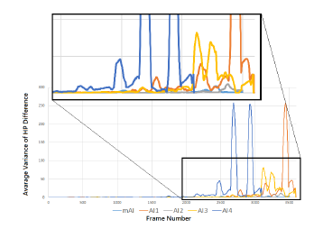
Gameplay Analyses
Now, in order to see how each AI affects the highlight cues in the proposed method, 1000 gameplay analyses were performed and the following parameters were observed:
Average Variance of the HP Difference(AVHPD):
Here it was observed that gameplay generated by the three AI-player types that use Score Transition (AI1, AI3, AI4), the HP difference between the two AI players varies more swiftly, causing a higher variance, near the end of round.

Slide 19
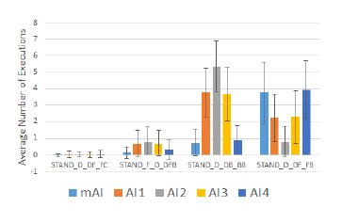
Average Use of RankAct Actions (AURAA):
It can be seen that, due to an emergent behavior governed by each term in the evaluation function, AI1 performed the 2nd and 3rd ranked actions in the RankAct list more frequently than mAI although the latter performed the 4th ranked action more frequently than the others except for AI4. This result in part substantiates the superiority of AI1 over mAI in the user study. However, the 1st ranked action in RankAct, the one with the highest visual effect which requires a large amount of energy to perform, was rarely executed by AI1 and its variants.

Slide 20
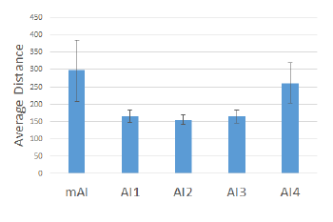
Average Distance Between the Two Characters (ADBTC):
It can be clearly seen that the gameplay generated by AI1, AI2, and AI3 that include Distance in the evaluation function represents a close-distance fight. In addition, mAI and AI4 with no Distance in the evaluation function generate fights where the two characters keep a further distance between each other. This finding shows that Distance successfully constrains the distance between the characters during their fight.

Slide 21
Conclusions
In this paper, we proposed a fighting game AI with the aim to generate entertaining gameplay.
Based on existing highlight generation methods, we introduced three cues for use in the evaluation function of MCTS.
Our results from the conducted user study showed that the proposed method that has all of the three highlight cues, AI1, generated gameplay that was more fun than gameplay generated by an existing MCTS AI that aims at decreasing its opponent’s HP while maintaining its own HP.
These results were also substantiated by the conducted gameplay analyses. However, one issue is left as future work that is how to have an AI player of interest execute an action with a high visual effect that consumes a large amount of energy.

Slide 22
Bibliography
https://www.geeksforgeeks.org/ml-monte-carlo-tree-search-mcts/
http://ieeexplore.ieee.org.library.somaiya.edu/document/8848069

Slide 23
Implementation
Monte Carlo Tree Search will be implemented in python using PyCharms initially.
Then the proposed method will be implemented in PyCharms.
Finally I will try to implement the AI in FightingICE.

